Slide 1

SmartFit: AI-Driven Fitness Trainer and Personalized Recommendation System
Sahil Gorde 22107035
Soham Dewrukhkar 22107054
Varad Chaudhari 22107053
Siddhi Patwardhan 22107033
Project Guide
Prof. Sarala Mary
Notes:
1

Slide 2
Outline
Introduction
Literature Survey of the existing systems
Limitations of the existing systems
Problem statement
System Design
Technologies and methodologies
Implementation
Conclusion
References
Notes:
2

Slide 3
Introduction
The Smartfit project provides personalized workout plans and diet recommendations based on user data. By predicting metrics like BFP and BMI, it tailors fitness programs to individual goals, helping users achieve optimal health and fitness outcomes.
Motivation:
Generic workout plans fail to meet individual fitness needs.
Existing solutions lack real-time feedback and personalization.
Many users struggle with motivation and consistency.
Need for tailored, goal-specific routines to improve long-term success.
Notes:
3

Slide 4
Objectives
To provide personalized fitness plans based on user inputs using random forest and genetic algorithm.
To recommend diet plans that align with users' fitness goals and using random forest and genetic algorithm.
To improve the precision of exercise using OpenCV.
To calculate BMI and classify users into appropriate health categories .
Notes:
4

Slide 5
Literature Survey of the existing system
Title | Author | Year | Outcomes | Methodology | Results
[1] Exercise Recommendation Method Based on Machine Learning | Zhizhuang Li, Haiyang Hu, Zhipeng Xia, | 2022 | The objectives of this paper are to create a web-based exercise recommendation system using machine learning, enhance the accuracy and personalization of exercise plans, and address challenges such as cold start issues and limited exercise diversity. | Collaborative Filtering, Content-Based Filtering, Decision Trees, KNN, Hybrid Filtering | The result is an advanced exercise recommendation system that delivers highly accurate and personalized workout plans, effectively integrates multiple machine learning models, and addresses key challenges such as cold start issues and exercise diversity limitations.
[2]E-Health Monitoring System with Diet and Fitness Recommendation using Machine Learning | [2]Divya Mogaveera, Vedant Mathur, Sagar Waghela | 2009 | The outcomes are a system that effectively integrates various health sensors and provides real-time monitoring and recommendations, while facing challenges in ensuring data accuracy and security. | Machine Learning, Health Monitoring | The result is a comprehensive e-health monitoring system that offers personalized diet and fitness recommendations, utilizes real-time data from wearable devices for health tracking, and manages challenges related to sensor integration and data security.
Notes:
5

Slide 6
Literature Survey of the existing system
Title | Author | Year | Outcomes | Methodology | Results
[3] Computer Vision Imaging Based on Artificial Intelligence | Li Xin, Shi YiLiang | 2024 | The system incurs significant computational expenses due to complex image processing algorithms and demands large volumes of data for effective model training, which can limit efficiency and scalability in practical applications. | OpenCV, AI (Machine Learning for Image Processing) | The result is a computer vision system that achieves precise object detection and recognition using OpenCV and AI, with efficient edge detection and image segmentation capabilities..
[4]Assessing Human Motion During Exercise Using Machine Learning | Fotos Frangoudes, Maria Matsangidou, Eirini C. Schiza, Kleanthis Neokleous, Constantinos S. Pattichis | 2024 | The system faces data privacy concerns and challenges in capturing fine-grained motion without specialized equipment, which may affect overall effectiveness and user acceptance | Machine Learning, Motion Analysis . | The result is a motion analysis system that enhances the accuracy of human motion analysis for exercise and offers potential benefits for rehabilitation and performance improvement
Notes:
6

Slide 7
Limitations of existing systems
Lack of Real-Time Personalization: Most fitness apps don’t provide immediate, personalized feedback based on user performance, limiting dynamic interaction.
Fragmented Workout and Diet Plans: Many systems fail to integrate workout routines and diet plans, forcing users to manage these separately, creating inefficiencies.
Limited Use of AI and Computer Vision: AI and computer vision are underutilized in real-time fitness feedback, limiting personalized guidance and interaction.
Notes:
7

Slide 8
Problem Statement
No Real-time Feedback: Lack of real-time exercise feedback.
Manual Input Dependency: Users rely on manual input, leading to inconsistent and inaccurate data.
Fragmented Systems: Workout and diet recommendations are not integrated.
Poor Body Classification: Inadequate user classification based on BMI and BFP.

Slide 9
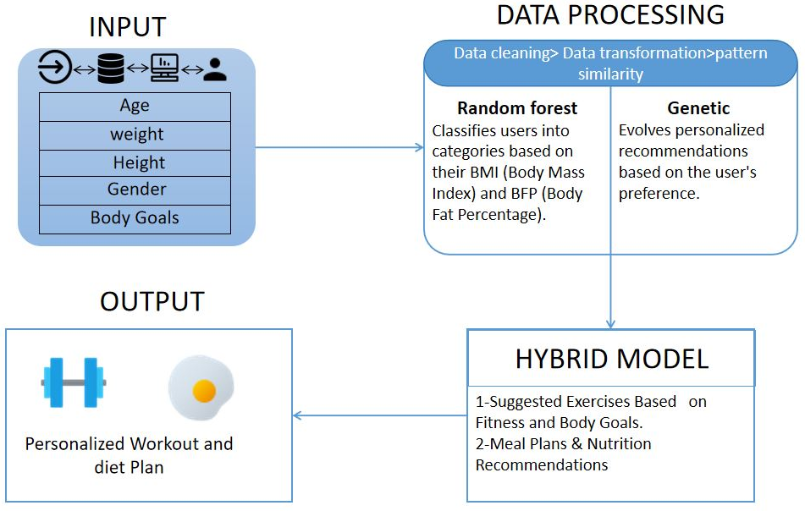
System design
Notes:
9

Slide 10
Technologies and methodologies
Frontend Development:
HTML5
CSS3
JavaScript ES2024
Backend Development:
Flask Framework 8.0
Machine Learning:
Algorithms Used: Random Forest, Genetic Algorithm
Computer Vision:
Library: OpenCV , Mediapipe
Dataset:
user(5001x9),exercises(150x10), food and nutrition dataset (281x9)
Notes:
10

Slide 11
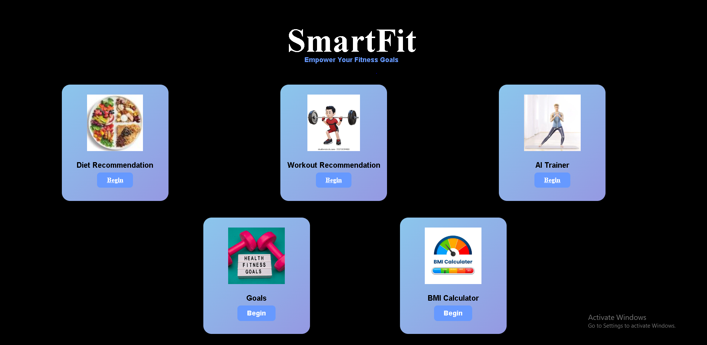
Implementation
Notes:
11

Slide 12
Conclusion
The SmartFit AI Fitness Trainer and Diet Recommendation project offers a personalized fitness solution using Genetic Algorithms, Random Forest for workouts and diet plans, and OpenCV for real-time feedback. It addresses key issues like poor classification and manual input errors, providing accurate, dynamic, and adaptable recommendations for a better user experience and healthier lifestyles.
Notes:
12

Slide 13
References
[1] Zhizhuang Li, Haiyang Hu, Zhipeng Xia, "Exercise Recommendation Method Based on Machine Learning," Journal of Computational Science (Elsevier),2022.
[2] Jong-Hun Kim, Jung-Hyun Lee, Jee-Song Park, "Design of Diet Recommendation System for Healthcare Service Based on User Information,"Healthcare Informatics Research (Springer) 2009.
[3] Li Xin, Shi YiLiang, "Computer Vision Imaging Based on Artificial Intelligence," IEEE Transactions on Pattern Analysis and Machine Intelligence (IEEE)2024.
[4] Fotos Frangoudes, Maria Matsangidou, Eirini C. Schiza, Kleanthis Neokleous, Constantinos S. Pattichis, "Assessing Human Motion During Exercise Using Machine Learning: A Literature Review," 2024.
Notes:
13

Slide 14
Thank You...!!
Notes:
14

